Slide 1


GMP
GENETICALLY MODIFIED PLANTS
Dr. Manoj Kumar Sharma
Department of Botany,
J.V. College Baraut

Slide 2
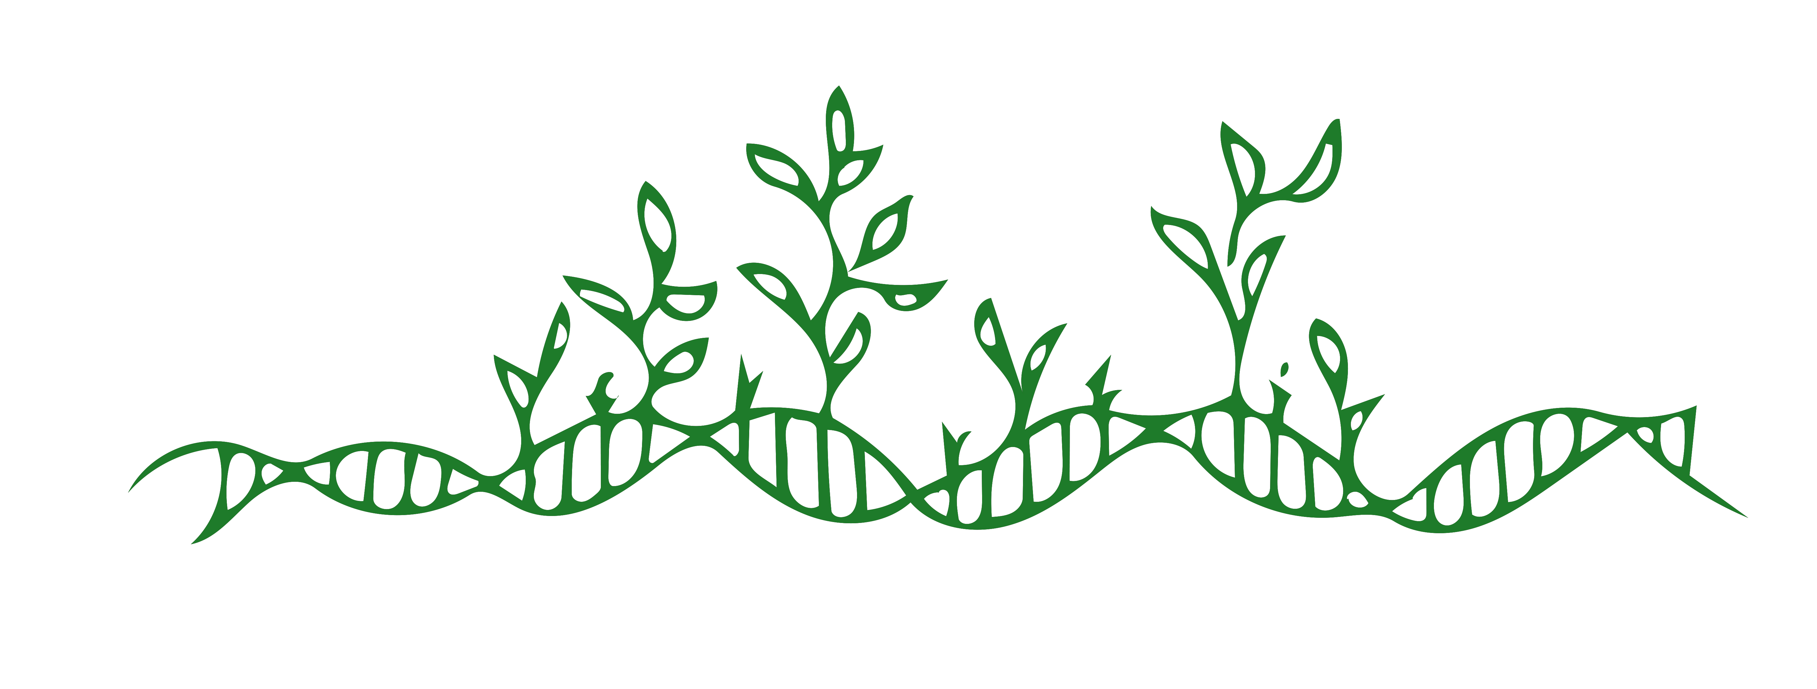
Overview
Introduction
Traits introduced by GM
Case studies
Ethical issues
Controversies
Conclusion

Slide 3
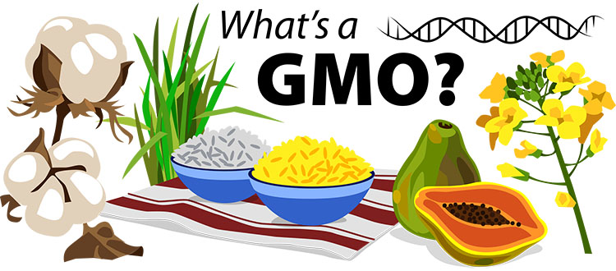
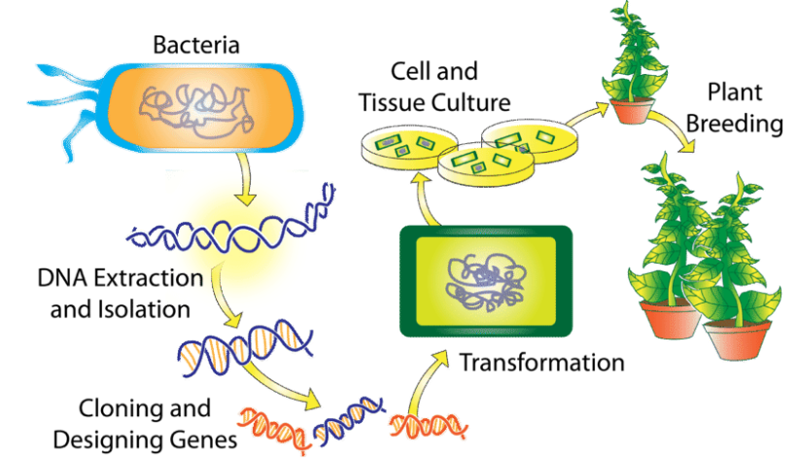
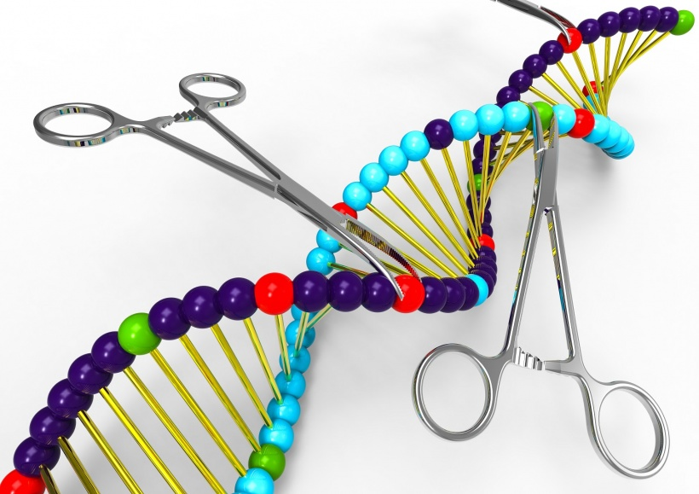
Introduction

Slide 4
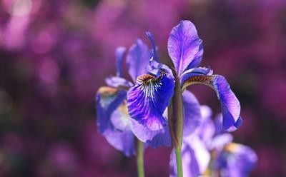

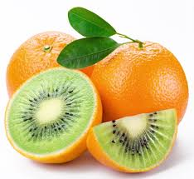
Traits introduced by GM
Insect resistance
Disease resistant
More yield
aaa
Improved
nutrient
content
Herbicide
tolerance
Medicinal
property

Slide 5
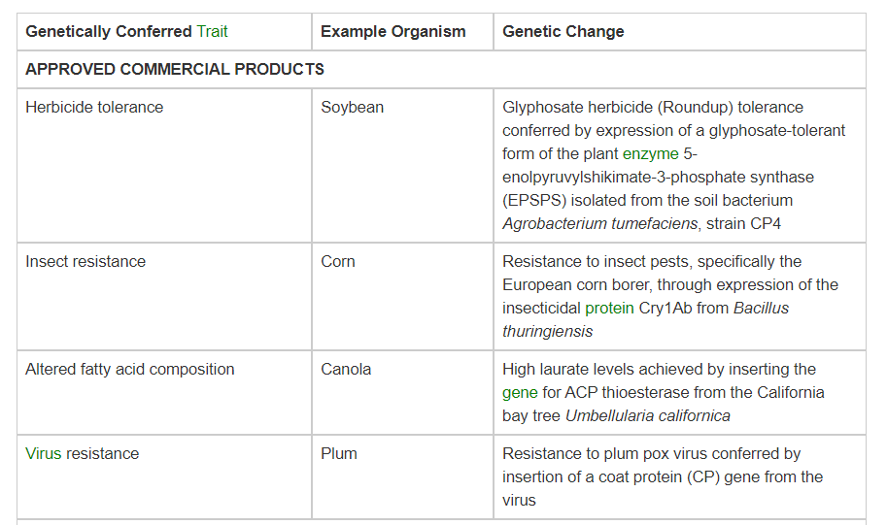

Slide 6
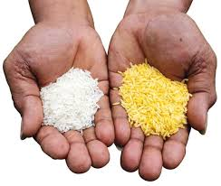
Case studies
Golden rice
Attractive yellow colour
More nutritious
Vitamin A content
Golden rice was created by modifying the rice genome to include a gene
from the daffodil Narcissus pseudonarcissus that produces an enzyme
known as phyotene synthase and a gene from the bacterium Erwinia uredovora
that produces an enzyme called phyotene desaturase. The introduction of these
genes enabled beta-carotene, which is converted to vitamin A in the human liver,
to accumulate in the rice endosperm—the edible part of the rice plant—thereby
increasing the amount of beta-carotene available for vitamin A synthesis in the body.

Slide 7
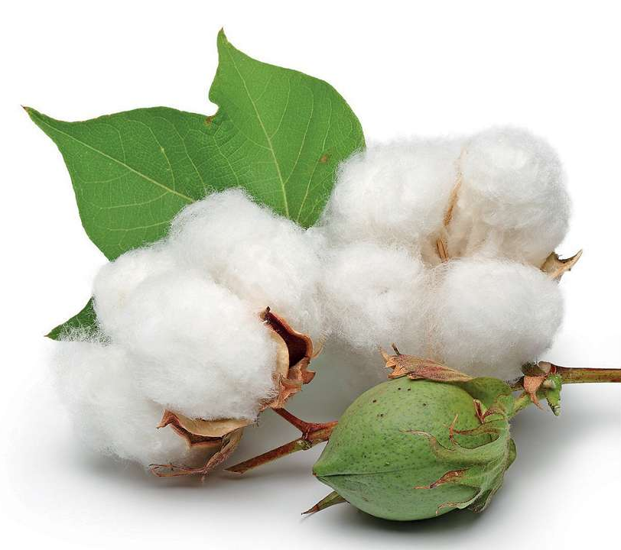
Bt cotton
Increases yield of cotton
Reduction in insecticide use.
Potential reduction in the cost of cultivation
Reduction in predators.
No health hazards due to rare use of insecticides
Bt cotton was created through the addition of genes encoding toxin crystals in the Cry group of endotoxin.
When insects attack and eat the cotton plant the Cry toxins or crystal protein are dissolved due to the high
pH level of the insect's stomach. The dissolved and activated Cry molecules bond to cadherin-like proteins
on cells comprising the brush border molecules. The epithelium of the brush border membranes separates
the body cavity from the gut while allowing access for nutrients. The Cry toxin molecules attach themselves
to specific locations on the cadherin-like proteins present on the epithelial cells of the midge and ion
channels are formed which allow the flow of potassium. Regulation of potassium concentration is essential
and, if left unchecked, causes death of cells. Due to the formation of Cry ion channels sufficient regulation
of potassium ions is lost and results in the death of epithelial cells. The death of such cells creates gaps in
the brush border membrane.

Slide 8
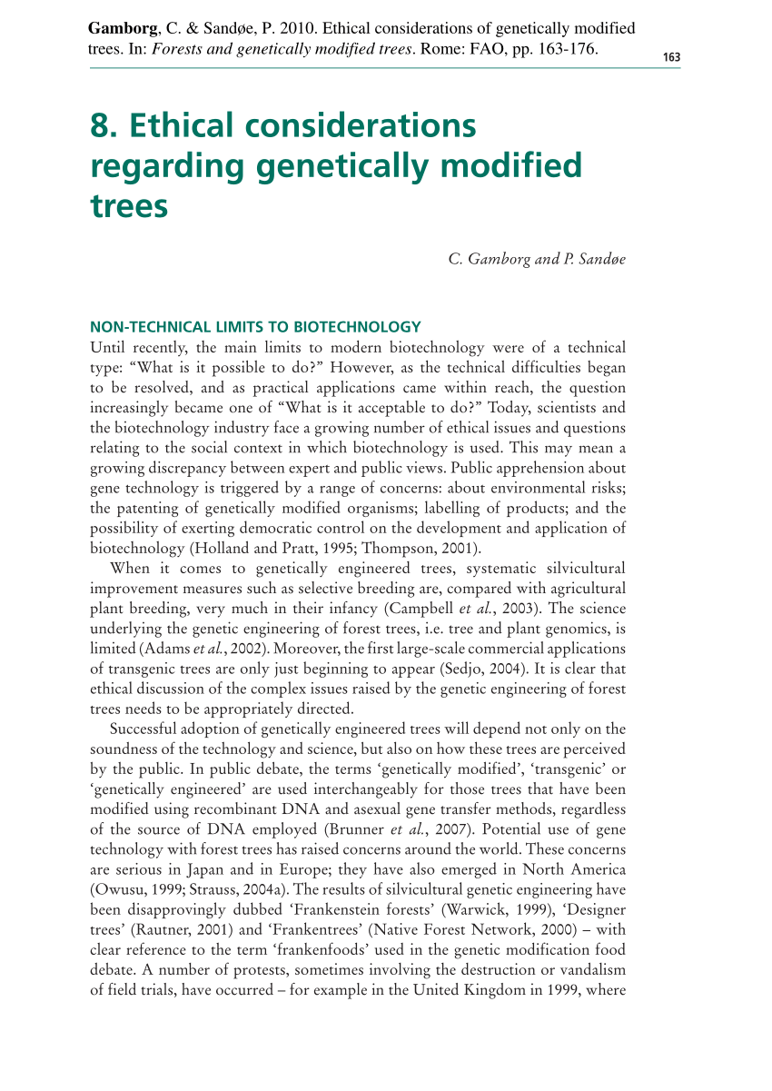
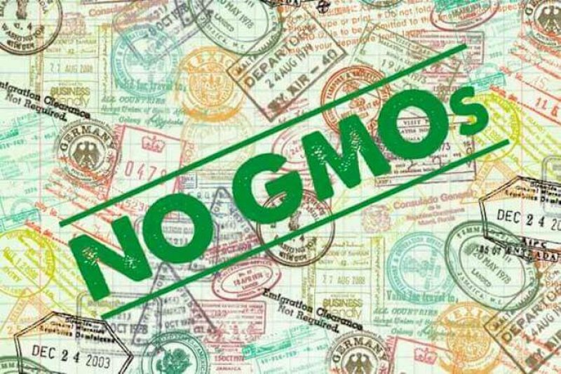
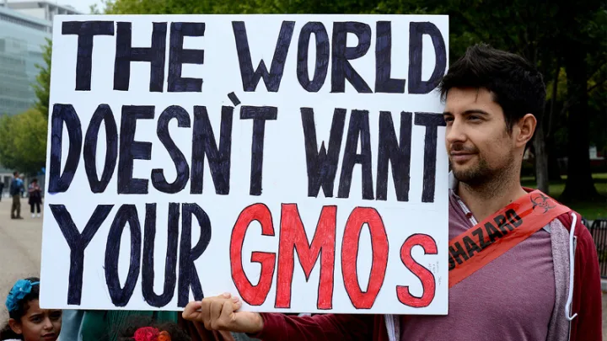
Ethical issues

Slide 9
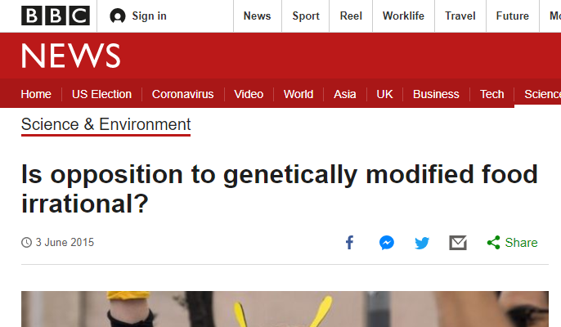
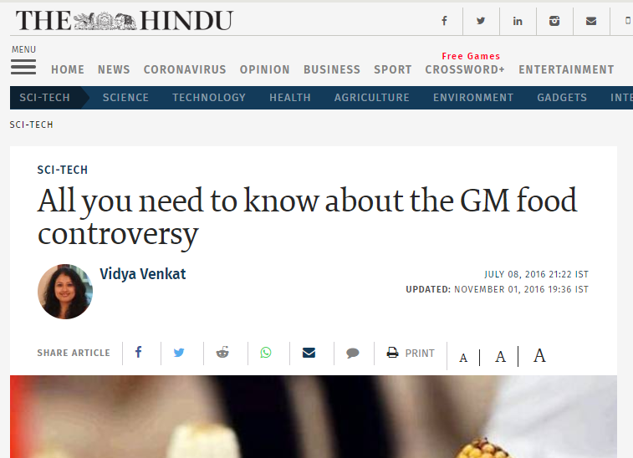
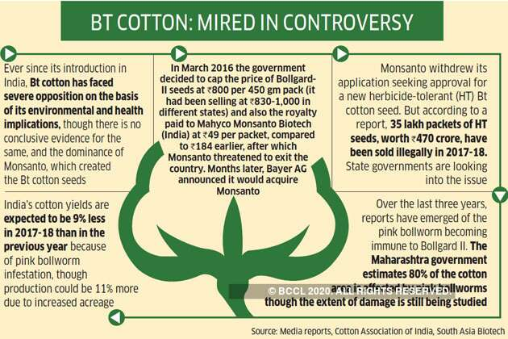
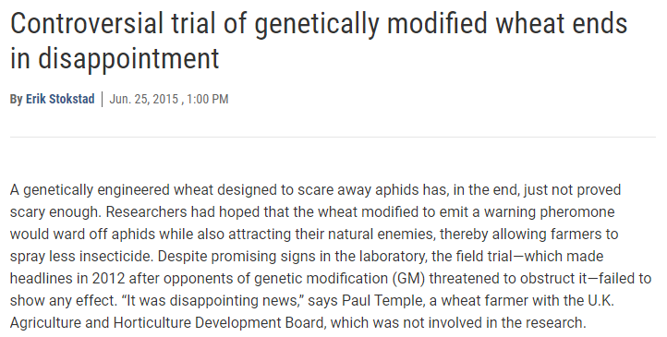
Controversies

Slide 10
Conclusion
Need of the day
Can overcome starvation and meet increasing demands due to population explosion
Proper protocol need to be maintained
No side effect for environment
Avoid irrelevant exploitation

Slide 11


